Slide 1
2020
Telecommunications Workshop

Slide 2
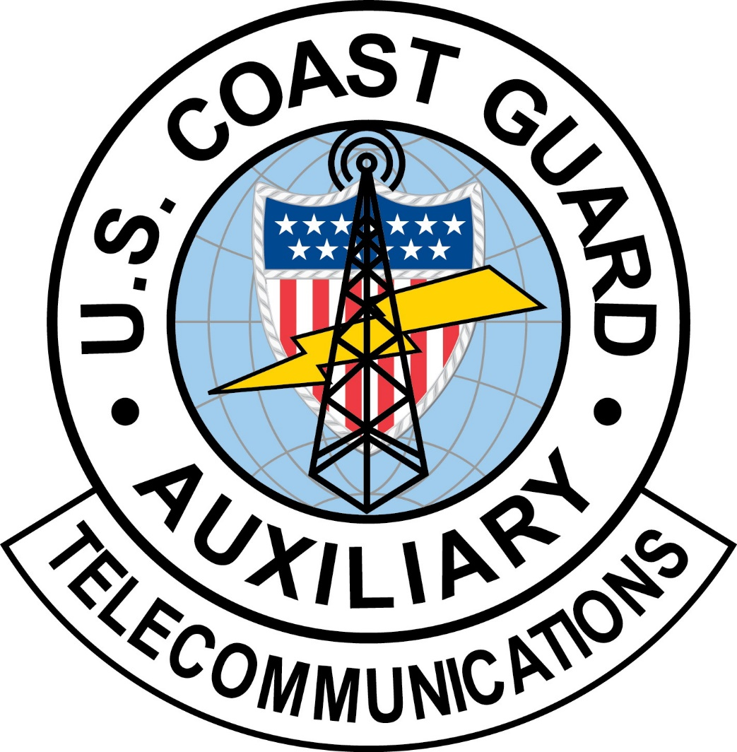
Auxiliary Telecommunications
2

Slide 3
Welcome
This workshop will:
Present Risk Management
Review existing policies and procedures
Review current communications programs and missions
Preview new programs, procedures, and missions
Review watch standing recruitment
This is an optional workshop, but it may be “required” at the local level for all Telecommunications Operators (TCO)
3

Slide 4

Ground Rules
This workshop should be interactive, NOT a Lecture
  Ask Questions
  Answer Questions
  Share Experiences
  Share Insights
Participate – Participate - Participate

Slide 5
Risk Management
2020 Risk Management Discussion
5

Slide 6
What is Risk Management
A continuous, systematic process of identifying and controlling risk in all activities according to a set of pre-conceived parameters by applying appropriate management policies and procedures.
This process includes detecting hazards, assessing risk, and implementing and monitoring risk controls to support effective, risk-based decision-making.
6
Notes:
Note the word CONTINIOUS . Risk Management must be done throughout the mission not just at the beginning for a GAR score, and just for Surface or Air operations

Slide 7
Risk Management
Risk Management is more than a form or a process.
It is a mindset and awareness of risk and reward that can be used not only in your Auxiliary life but in everything that we do.
7

Slide 8
Risk Management As A Way Of Life
We continually make decisions based on how much risk we are willing to accept in personal life and also in the Auxiliary
By increasing our understanding of Risk and Risk Management, we will increase our performance and safety
Marijuana is not legal for use under federal law
8
Notes:
Note to Instructor. On the “Marijuana is not legal for use under federal law” bullet there will be NO additional discussion or clarification

Slide 9
Risk Management As A Way Of Life
We Take Steps To Mitigate The Risks
  Ask for Help
  Modify Our Plans
    Change Our Start Time
    Change Our Route
  Check Our Equipment
9

Slide 10

Risk Management
Coast Guard (including Auxiliary) operations are inherently complex, dynamic, potentially dangerous, and, by nature, involve the acceptance of some level of risk
Due to these issues the Coast Guard has revamped the Risk Management program, including what we know as TCT
10

Slide 11
Major Changes to RM
The Risk Management Instruction;
  Updates the RM process from 7 steps to the new 5 step process
  Reintroduces the PEACE and STAAR models
  Introduces the Risk Assessment Matrix (RAM)
  Mandates the use of GAR 2.0
  Standardizes RM training for all communities (surface, air, shore)
11

Slide 12
What You Need to Do as a TCO
Complete the Introduction to Risk Management training course on AUXLMS, course 100202
  This is a one-time training requirement to introduce the principals of RM and the critical human factors skills
  Annually complete TCT refresher class
12

Slide 13
CONCEPT OF OPERATIONS
CONCEPT OF OPERATIONS – CONOPS –
  http://rdept.cgaux.org/documents/Comms/AuxiliaryCommunicationsProgramSOP.pdf - was released on 21 March, 2016 for Auxiliary Communications and provides a foundation for the growth and development of current Auxiliary communications capabilities - while conveying to the US Coast Guard Auxiliary (CGAUX) and the US Coast Guard (CG), the role, assets, activities, operations and overall policies of the Auxiliary Communication System (ACS)
  Communication officers at all levels, are responsible for maintaining an accurate radio communications resource availability list. (See: ICS Form 217A CG)
Notes:
Concept of Operations for Telecommunications - Overall goal is to Maximize our Telecommunications resources in support of CG activities.

Slide 14
Authorized Operation of Radio Facilities
Only Auxiliary staff or elected officers may activate Auxiliary radio facilities under one or more of the following conditions:
For a mission ordered or scheduled by the Coast Guard
• When necessary to handle valid distress traffic
• While conducting technical tests to determine a facility’s capability (e.g., facility inspection)
• When necessary to contact a Coast Guard unit to determine if Auxiliary help is required
14
Notes:
This slide talks to a narrow scope of ordered missions.

Slide 15
Authorized Operation of
Radio Facilities (Cont.)
When conducting net drills
For assisting in time of disasters or national emergencies
• When necessary to conduct authorized Auxiliary activities as assigned by appropriate Coast Guard unit, Auxiliary Operational Commanders or Staff officers
Reference: Operations Policy Manual, Annex 4.C.4
15

Slide 16
Authorized Operation of
Radio Facilities (Cont.)
“Qualified Auxiliarists” must have completed AUXCOM prior to August 1, 2008 or be TCO (PQS) qualified
  Auxiliarists may offer their radios to be used as Auxiliary facilities. If accepted, a single facility identification for all radios at the facility (HF and VHF) used in the same service will be assigned by DIRAUX and the information entered in AUXDATA
DIRAUX issues FACILITY ID NUMBERS and approves all VHF callsigns which may be assigned by District CM Staff.
The DVC-RT issues all HF callsigns
16
Notes:
The facility ID is NOT the call sign of the radios at the station, the Call Signs are separately assigned according to the Ops Policy Manual and by District procedures (see bullet point).

Slide 17
Radio Basics
In all radio communications, we are to act as professionals
At no time shall we make reference to ethnicity, race, gender, sexual orientation or religious affiliation in radio transmissions
This is a zero-tolerance policy and must be strictly adhered to
17

Slide 18
Radio Basics (Cont.)
It is often not what you say, but how you say it that demonstrates your professionalism
Brevity and accuracy supports mission success and safety
Remember, the public and other agencies “hear” you as the voice of the U.S. Coast Guard
Practice and use proper radio procedures to achieve success, safety, and professionalism
  (No “10” codes, no “Over and Out”, etc.)
18

Slide 19
Radio Basics (Cont.)
REMEMBER:
When you key the microphone on your radio “The Whole World is Listening!”
Always listen before transmitting and be sure you are on the correct channel (frequency) and no one else is talkin
19

Slide 20
VHF Communications
7 CG Auxiliary narrow band VHF frequencies are available for our use on narrow band radios with maximum allowed output power of 50 watts
VHF repeaters are allowed an output power of 100 watts
Maximum output power on channels in the Marine band is 25 watts
No power amplifiers allowed on VHF radios
20
Notes:
These frequencies are in the 136-174 MHz frequency range., excluding the 2-Meter. Amateur band, 144-148 MHz.
Encrypted radios may be loaned on an as needed basis and returned following the activity.

Slide 21
VHF Communications (Cont.)
RDF (Radio Direction Finding) stations are authorized
VHF handheld marine radios MAY be accepted as mobile facilities in special cases
APRS (Automatic Packet Reporting System) is not authorized
MMSI (Maritime Mobile Service Identity) numbers are not authorized for Auxiliary aircraft
21

Slide 22
VHF REPEATERS
There are 56 Auxiliary VHF repeaters currently throughout the United States, most of which share common input/output frequencies, with varied CTCSS tone access. Most are unit owned
Repeater requests (CG Form 6086) must be reviewed by CG Office of Spectrum Management before construction or implementation
Maximum output power of 100 watts
Narrowband only
7 possible frequencies
22

Slide 23
HF Communications
HF serves as a platform for other missions:
  AUXMON (Auxiliary Monitoring Mission) A quality control program for Coast Guard broadcasts
  AUGCOM GMDSS monitoring for digital and SSB voice distress calls (replaces the old SSB voice distress calls) http://rdept.cgaux.org/documents/Comms/AUGCOM/AUGCOM%20Mission%20Final%20to%20BSX%202016_PDF.pdf
  SHARES – A DHS administered radio program coordinating a voluntary network of government, industry, and disaster response agency HF radio stations used for emergency communications
23
Notes:
AUGCOM is augmenting of Coast Guard Communication systems.

Slide 24
HF Communications (con’t)
  Maximum power output 1000 watts on HF radios
  Usable for Auxiliary HF radio Nets
  41 frequencies 2-23 MHz are available
  Radios must be able to transmit outside of Amateur bands
  Accommodates digital modes
  Supports CG contingencies and SHARES
Radios must meet NTIA standards
Reference: http://rdept.cgaux.org/documents/BeQualified/BecomingQualifiedAuxiliaryHighFrequencyProgram.pdf
24
Notes:
Radios used for HF operations must meet NTIA (National Telecommunications and Information Agency) standards for stability, purity and capabilities of output.

Slide 25
CG Station Radio Watchstanding
Auxiliary Watchstanders at a CG station must complete the same training as active duty CG watchstanders and stand a “board examination”
  They must have received, or applied for, DO security clearance prior to being certified as a CG Watchstander
  Watchstanders serve at the Station CO’s discretion
AUXCOM or TCO/PQS are helpful and might be required at the discretion of the station OIC
25

Slide 26
Auxiliary Station Watchstander
Watchstanders at an Auxiliary Communications unit (ACU) must be certified as TCO or completed AUXCOM prior to August 1, 2008
  Must be TCO certified if the chief operator in a multiple-operator situation
  Other requirements might be required, on a District to District basis
  A radio watch requires that the station is actively manned and the operator is ready for intervention
26

Slide 27
SHARES (Shared Resources)
Administered by DHS
This program provides the Federal emergency response community with a single interagency emergency message handling and frequency spectrum management system
SHARES promotes interoperability between HF radio systems used by Federal departments and agencies and monitors applicable regulatory, procedural, and technical issues

Slide 28
SHARES (Cont.)
  To apply for SHARES membership only use the Auxiliary furnished application, Form 1, available only from DVC-RT
  Do not use SHARES furnished application
  Use Auxiliary HF call sign when logging into a SHARES net
  The DVC-RT acts as a facilitator of the application process
  See: http://www.dhs.gov/shares
28

Slide 29
AUXMON
AUXMON stations monitor CG broadcasts to mariners on stations located on the East Coast, Gulf Coast and Pacific Coast
The Coast Guard broadcasts are by voice, digital, and FAX, all on HF marine frequencies
Members monitor and report any problems to the CG Communications Command (CommCom)
29

Slide 30
AUXMON (Cont.)
HF radio equipment and special software is required to participate in the AUXMON program
Additional AUXMON members are needed
For application, please see:
  http://rdept.cgaux.org/documents/Comms/AUXMONApplicationrs.pdf
30
Notes:
HF stations and AUXMON stations require special authorization from National

Slide 31
Who is in charge?
Notes:
CG COMMCOM is the command responsible for CG HF operations worldwide, and for oversight of Auxiliary HF operations

Slide 32
CHANGE AGENTS
Technology – voice to digital communications
Wide band VHF shifts to narrowband NTIA compliant, except for Marine channels
GMDSS replaces traditional SSB MF/HF distress messaging
August 1, 2013 - Coast Guard halted monitoring of 2182 MHz SSB for distress calls and 2670 KHz VOBRA
Rescue 21 implemented for Sea Area 1, VHF
COMMCOM Email of July 2015
http://wow.uscgaux.info/Uploads_wowII/R-DEPT/COMMCOM_MEMO_SMLL_SIZE.pdf
Auxiliary TC Concept of Operations released in 2016
32

Slide 33
AUXILIARY COMMUNICATIONS
SYSTEM - 2016 & Beyond
VHF Communications
MF/HF Communications
Station Watch Standing
AUXMON
SHARES
AUGCOM
33

Slide 34
AUGCOM MISSION
Specifics of AUGCOM mission released Mar. 31, 2016 See //rdept.cgaux.org/documents/Comms/AuxiliaryCommunicationsProgramSOP.pdf
Directly supports the CG COMMCOM, Sectors and other CG Commands
Aids response to GMDSS HF maritime services for sea area A-2
Participants are a select group of qualified Auxiliary HF facilities and designated as AUGCOMSTA
http://rdept.cgaux.org/documents/Comms/AUGCOM/AUGCOM%20Recruiting%20Statement%20rev926.pdf
34

Slide 35
WHAT IS A FACILITY?
The Coast Guard counts assets: vessels, aircraft, and radios
DIRAUX assigns each asset a facility identification number, i.e. OPFAC # for a vessel, or Facility ID for a radio, i.e. NF81AA
The identification number is for record keeping only. You must insert this facility identification number in the box in Section III of the Mission Hour, Form 7030, where it calls for a facility registration number
35

Slide 36
WHAT IS A FACILITY? (Cont.)
DIRAUX approves VHF radio callsigns, which may be assigned by DIRAUX or the District CM Staff
  E.g. “Auxiliary Boston Radio”, where Boston signifies the location. DIRAUX does not issue Auxiliary HF callsigns
HF facility owners must forward a copy of their DIRAUX accepted Offer for Use Form 7004 to DVC-RT and BC-RTI for issuance of their HF callsign
36

Slide 37
FIXED LAND FACILITIES
Fixed land facilities are permanently located in an Auxiliary Communications Unit (ACU) either owned by the Auxiliary or in the residence, or similar building, owned by the radio facility owner
The location is FIXED and DIRAUX must authorize relocation of the radio facility via Form 7004
37

Slide 38
MOBILE RADIO FACILITIES
Mobile radio facilities are usually mounted in vehicles and can be used while the vehicle is in motion
Handheld radios are considered to be mobile
Movement at the direction of the CG requires orders via the AOM process
They are not to be confused with TRANSPORTABLE radio facilities
38

Slide 39
WHAT IS A TRANSPORTABLE FACILITY?
  A station which is transferred to various fixed locations but is not intended to be used while in motion
  Examples:
  Go-kit
  Trailer
  Boxed radio with accessories
39

Slide 40
TRANSPORTABLE (Cont.)
A transportable station is normally configured to permit it to be easily transported and set up for operation in various temporary locations
A transportable station should be ready for emergency deployment at all times, but is not used on a regular basis and is not used at a permanent location
Movement at the direction of the CG requires orders via the AOM process
40

Slide 41
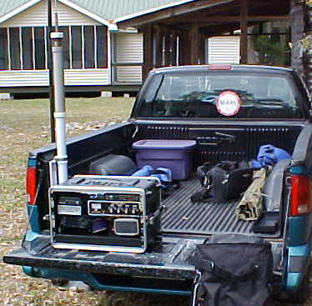
TRANSPORTABLE FACILITY
t
An example of a transportable radio facility is shown on the tailgate of the truck
41

Slide 42
Mishap Reporting
ALL mishaps must be reported to the Order Issuing Authority (OIA) immediately
A Coast Guard mishap is defined as any unplanned, unexpected or undesirable event that causes injury, occupational illness, death, material loss or damage.
Additionally the Auxiliary wants any incident which causes a disruption or alteration of the mission reported.
This allows the mishap to become an education opportunity to be shared across the entire organization.
Mishap reporting does not equal punishment
  However this does not apply for reckless or foolhardy actions.
  Incidents occur
  Not reporting a mishap may lead to punitive action
42
Notes:
Per COMDTINST_M5100.47.pdf - a Mishap is “An unplanned, unexpected, or undesirable event or series of events resulting in death, injury, occupational illness, or damage to or loss of materiel. “
Need to define MISHAP. Anything causing an unplanned stop besides a comfort stop is potentially reportable. Certainly any mechanical or maintenance issue, but people should use common sense in what they report. Anything that you expect to be reimbursed for should definitely be reported. That being said, it is better to over report than under report. Nobody will be criticized for reporting too much. When in doubt report it.
Operations Policy Manual requires those with firsthand knowledge of a mishap to report it. Let’s talk about that.
If you are confident that the principle parties are reporting to the organization, redundant reporting is not needed unless requested.
Why are they requesting that all mishaps; with or without injuries and even if there is no damage be reported?
Whenever a mishap occurs, even with no real damage or injury, is reported this information can be used to aid other members of potential risks and how this risk can be avoided.
This information you provided can be used as a learning or teaching event that can help all of us to become safer.

Slide 43
AOM Considerations
When a Mobile Radio Facility is directed to move, AOM orders are required. The Coast Guard OIA (order issuing authority) approves AOM orders.
When a Transportable Radio Facility is directed to move, AOM orders and DIRAUX approval are required
  In those situations where an operator (TCO), under orders, travels from home to arrive at a Fixed Land ACU, they are not eligible for AOM travel reimbursement. Depending on their ACU duty hours, relative to meal time, they may request reimbursement for meals through the AOM process
43

Slide 44
MARINE CHANNEL 16
Channel 16 is the international emergency/distress and calling channel
Always monitor channel 16 (at least in scan mode) even if there is a specific reason to monitor another channel (regatta, SAR case, guard channel, etc.)
Encourage all boaters to monitor channel 16 when underway
44

Slide 45
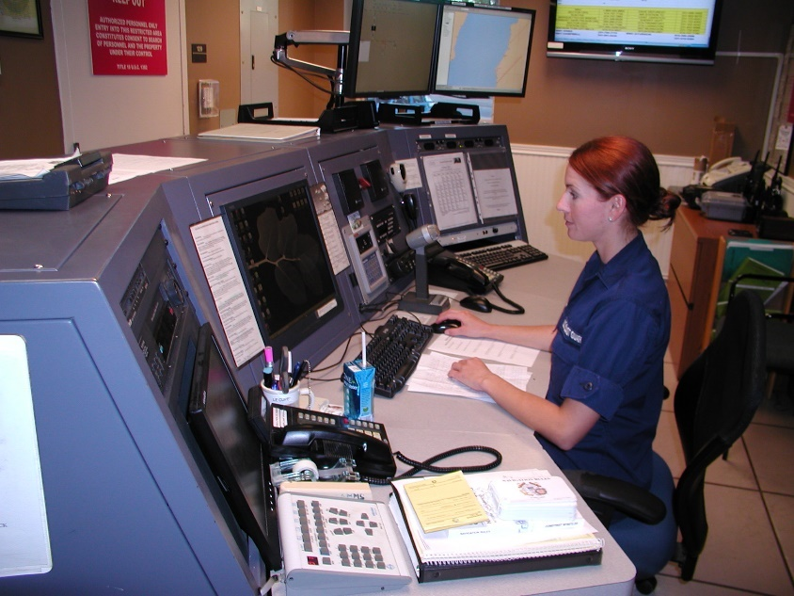
Coast Guard Watch Standing
The US Coast Guard has asked for Auxiliary members to become Coast Guard Communications Watchstanders (CWS).
What does a CG CWS do?
Common activities include:
Monitor and answer the radios and phones
Stand Guard for underway unit assets
Keep radio logs and document SAR cases
Give unit “Pipes”
Assist and keep informed the unit command structure
And more…
45
Notes:
Watchstanders can be at Auxiliary radio stations or at Active Duty Station/Sector Communications stations. Base requirements are the same. For duty at a Coast Guard Station additional training is required.
Coast Guard Auxiliary members may train to be a watchstander at a Coast Guard station when authorized by the CO/OINC at the station. The training requirements for Auxiliarists are the same as the requirements for regular Coast Guard. They must complete the Coast Guard Watchstander PQS, stand watch with a mentor, stand a Board, have current TCT training and successfully complete all other station requirements and have DO security clearance.
The training required to complete the Coast Guard Watchstander PQS, COMDTINST M16120.7A, along with other CG station watchstander requirements covers all relevant items specific to active duty operations.
TCO certification might be required by the station CO/OINC.

Slide 46
Watch Standing Recruitment
You are interested in becoming a CWS and helping a CG Unit. What do you do?
I am interested
Inform your Chain Leadership
Decide on a C.G. Unit to assist
Begin training at the C.G. Unit
Complete Sign-offs and pass an Oral Board
Start Dispatching
46

Slide 47
Watch Standing Requirements
Requirements:
  BQ qualified
  Passed AUXCOM (prior to 8/1/2009) or TCO
  Current with AUXMT
  Taken ICS 100, 200, 700, 800
  DO Security clearance for CG Watchstander position
Next steps:
  Request approval through FSO-CM to your FC
    CM/FC requests approval through Auxiliary Coordinator
47
Notes:
Members that completed AUXCOM prior to August 1, 2008 are authorized the same watchstander privileges and authority as TCO qualified members
AUXCOM/TCO may not be required by the Coast Guard CO/OINC but is still highly recommended and will make passing the PQS for Coast Guard easier.

Slide 48
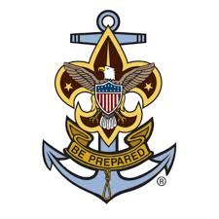
AUXSCOUT
Auxiliary-Sea Scout Youth Development Program
When involved with Sea Scouts observe all provisions of the SOP published 01 November 2019
Notes:
The Auxiliary and the Sea Scouts identified significantly beneficial prospects of enhancing their partnership including improved Sea Scout training opportunities, enriched Coast Guard and Auxiliary recruiting, and better overall promotion of recreational boating safety among our Nation’s boating public.
There are specific requirements when working with Sea Scouts that need to be followed,
Consent Forms
Required training specified training as defined in the SOP
Limitations in participation in SAR activities
Qualifications open to sea scouts
Refer to the SOP published 1 November 2019 for requirements and details

Slide 49
National Contact Information
Chief, Telecommunication Division
COMO David Elliot, DVC-RT
David.Elliot@cgauxnet.us
772-781-5969
Contingency Communications
David Rockwell, BC-RTC
david.rockwell@cgauxnet.us
727-823-7580
Program Integration
Don Wellons BC-RTI
donald.wellons@cgauxnet.us
912-266-4041
Coast Guard Support
Denis Rossiter BC-RTS
p.denis.rossiter@cgauxnet.us
717-249-9047
49

Slide 50

Bravo Zulu!
Thank you for your participation!
We seek your feedback on the content of this presentation.
Send your comments to:
Bruce.pugh@cgauxnet.us Division Chief – Education Division
Bruce Pugh, DVC-RE
David Elliot, DVC-RT
Rick Saunders, DIR-R
Roy Savoca, DIR-Rd
Notes:
V1.4final

